Slide 1
HUFFMAN CODING…
By Team Sign_IN

Slide 2
Course Details
Tutor Details
Course Title : Algorithm
Course Code : CSE 213
Name : Professor Dr. S M Aminul Haque
Professor & Associate Head
Department of CSE

Slide 3
NAME OF THE TEAMMATES
MD. Sazzadul Islam Shaon
MD. Masud Rana Nayeem
Mubarak Hossain Razwan
ID : 0242310005101028
ID : 0242310005101849
ID : 0242310005101027
Hasib Hossain
S M Sadman Al Siam
ID : 0242310005101123
ID : 0242310005101195

Slide 4
TABLE OF CONTENTS
01
02
03
04
05
06
INTRODUCTION
THE PROBLEM
THE SOLUTION
FIXED LENGTH
VARIABLE LENGTH
CONCLUSION

Slide 5
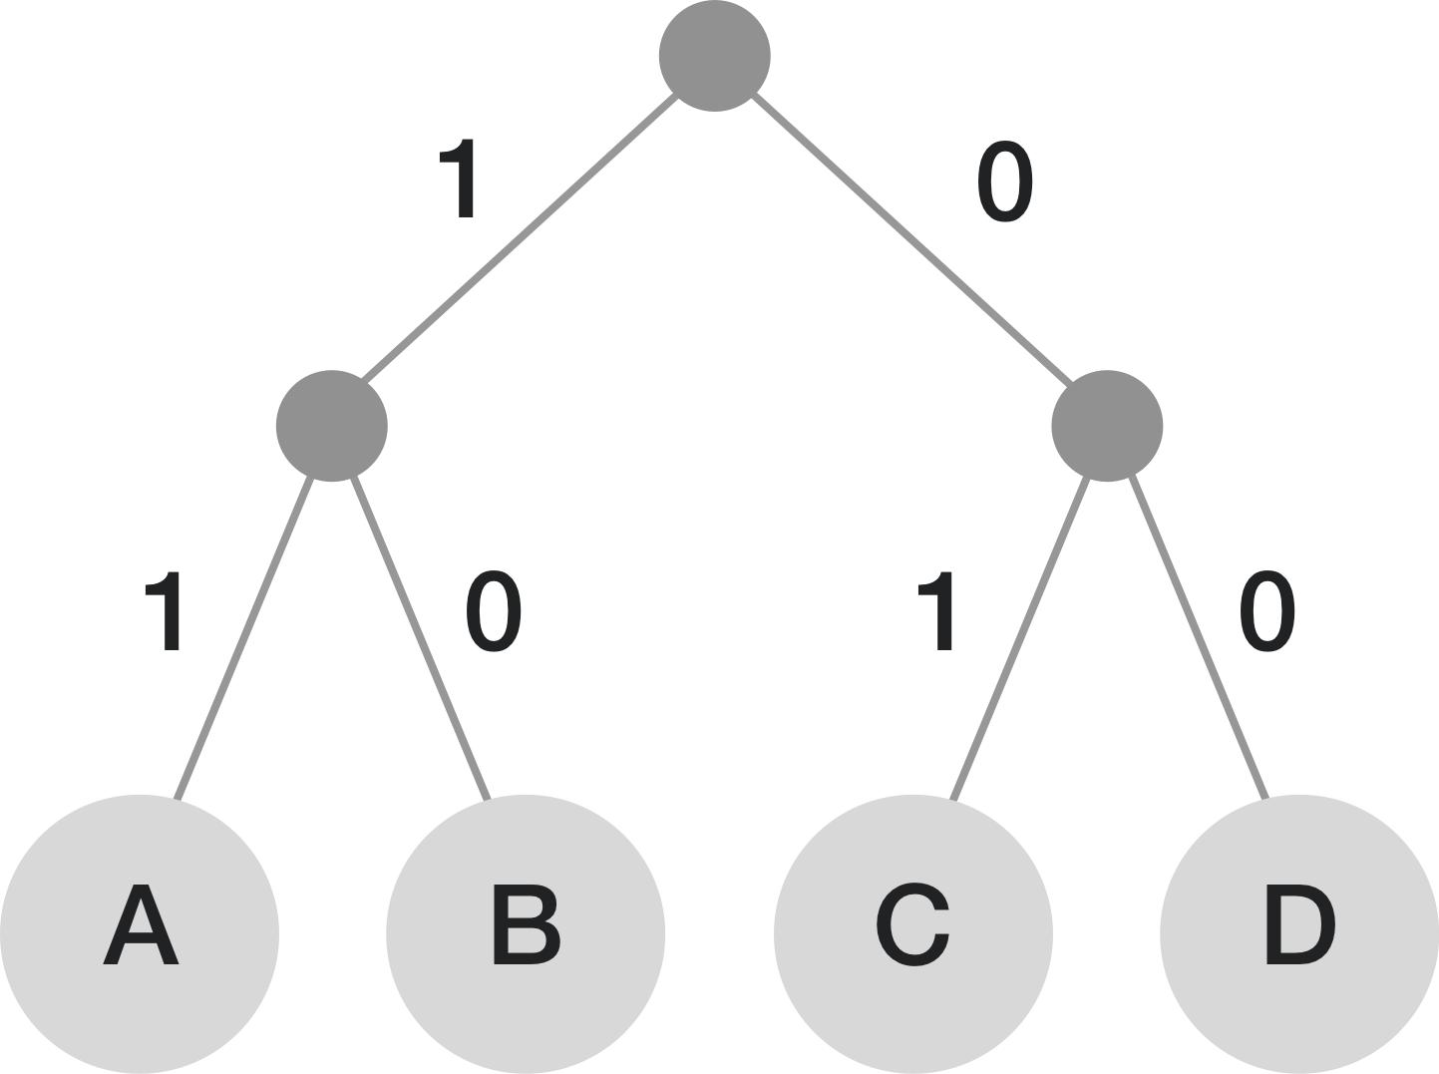

INTRODUCTION
Huffman coding is a lossless data compression technique.
Developed by David Huffman in 1952.
Assigns variable-length codes to symbols based on their frequency of occurrence.
More frequent symbols get shorter codes, reducing overall data size.

Slide 6
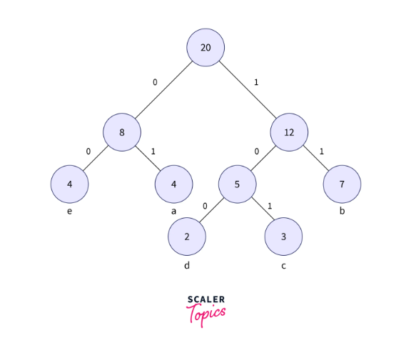
Problem addressed by Huffman Coding
Redundancy in data: Data often contains repetitive characters, leading to wasted space.
Inefficient storage and transmission: Fixed-length coding for all characters can be inefficient, especially for data with skewed symbol frequencies.

Slide 7
Problem Solved by Huffman Coding
Redundancy:
Analyzes symbol frequencies to identify frequently occurring characters.
Assigns shorter codes to these frequent symbols, reducing the overall number of bits needed to represent the data.
Inefficiency of Fixed-Length Coding:
Avoids allocating the same number of bits to all symbols regardless of frequency.
Optimizes code lengths based on symbol probabilities.
Reduces wasted space for frequent symbols, leading to a more compact data representation.

Slide 8
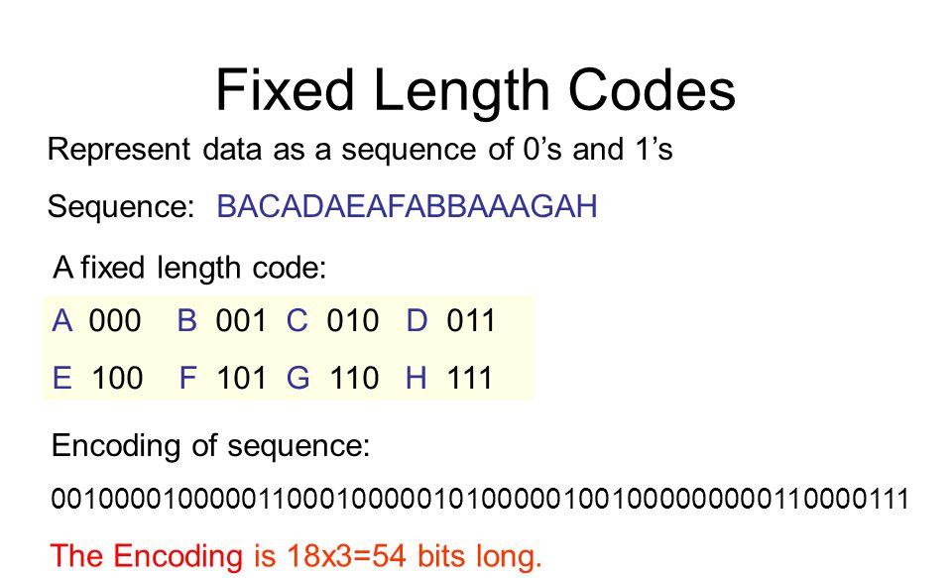
Fixed Length Coding
Implementation
Assigns a fixed number of bits to each symbol (character) in the data.
Simplest approach, but can be inefficient for data with skewed symbol frequencies.
Number of bits required per code: ceil(log2(total symbols))
Example: Consider 6 symbols (A, B, C, D, E, F).
Total symbols = 6
Number of bits = ceil(log2(6)) = 3 (minimum number of bits to represent 6 unique symbols)

Slide 9
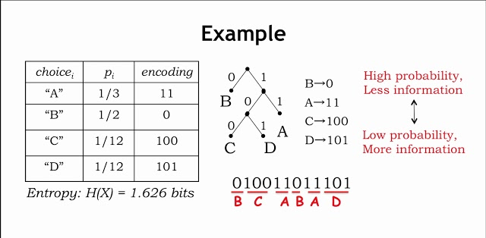
Variable Length coding
Implementation
Assigns codes of different lengths to symbols based on their frequency of occurrence.
More frequent symbols get shorter codes, reducing overall data size.
Huffman coding algorithm builds a Huffman tree based on symbol frequencies.
The tree structure determines the code length for each symbol.
Traverse the tree from root to leaf, assigning a 0 for a left path and a 1 for a right path.
The code for a symbol is the concatenation of bits encountered during the traversal.

Slide 10
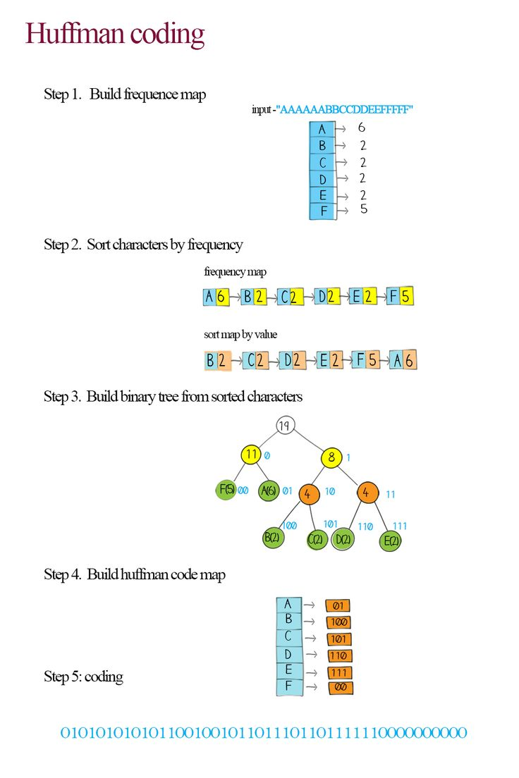

Slide 11
Conclusion
Huffman coding is a powerful lossless data compression technique.
Reduces data size by assigning variable-length codes based on symbol frequencies.
Improves storage efficiency and transmission times.
Widely used in various applications like file compression, image compression, and network communication.

Slide 12
THANK
YOU…;

Slide 13
ANY
QUESTIONS…?

